Slide 1

Animal Classification Using Neural Networks
Leveraging Transfer Learning for Enhanced Accuracy

Slide 2

Introduction
This presentation explores the application of neural networks and transfer learning in animal classification. We will present the significance of classification tasks, the fundamentals of neural networks, and the advantages of transfer learning, along with relevant case studies that demonstrate their effectiveness in real-world scenarios.

Slide 3
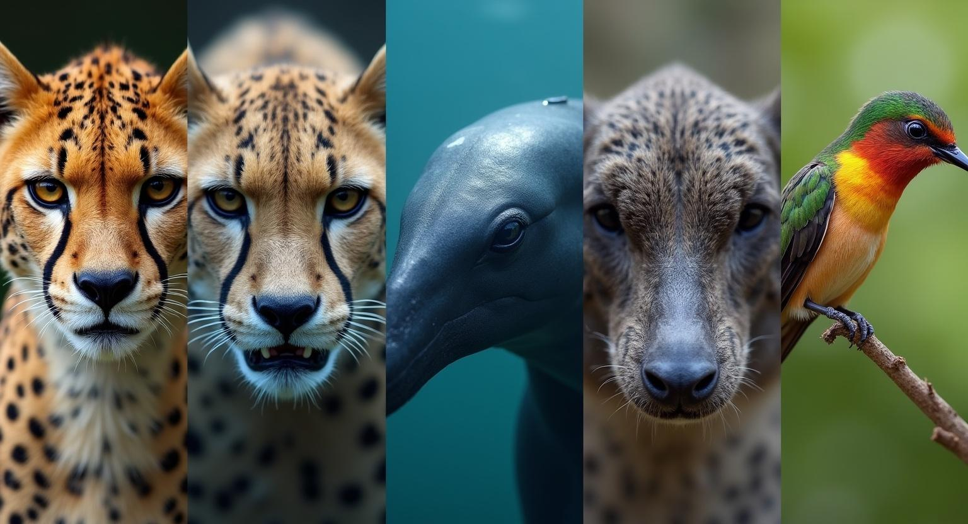
01
Introduction to Animal Classification

Slide 4
Overview of Classification Tasks
Animal classification plays a crucial role in biodiversity research, conservation, and ecology. With the advancement in machine learning, neural networks enable effective processing of complex data sets, enhancing the accuracy of classification models significantly.

Slide 5

Importance of Accurate Classification
Accurate animal classification helps in effective resource management and biodiversity conservation. It enables researchers to monitor populations, track species diversity, and implement strategies for sustaining ecosystems, ultimately contributing to environmental protection and restoration.

Slide 6
Applications in Various Fields
Animal classification utilizing neural networks has vast applications across various fields, including wildlife conservation, agriculture, and veterinary science. In conservation, it aids in monitoring endangered species; in agriculture, it supports pest identification; and in veterinary science, it enhances diagnostic accuracy for diseases, ensuring better animal health management.

Slide 7

02
Neural Networks and Transfer Learning

Slide 8
Fundamentals of Neural Networks
Neural networks are computational models inspired by the human brain. They consist of interconnected layers of neurons that process input data, allowing for complex pattern recognition. Their architecture can be adjusted to create deep learning models, facilitating improved performance in classification tasks for diverse datasets.

Slide 9

Role of Transfer Learning in Classification
Transfer learning involves taking a pre-trained model on a large dataset and fine-tuning it for a specific classification task. This approach drastically reduces the time and resources needed for model training while improving accuracy, especially when data availability is limited in a target domain, making it highly effective in animal classification tasks.

Slide 10
Case Studies of Successful Applications
Several successful applications of neural networks and transfer learning include the identification of endangered species from camera trap images and classifying animal sounds in ecological studies. These case studies highlight how advanced methodologies contribute to better conservation efforts and species monitoring, showcasing the practical benefits of these technologies.

Slide 11
Conclusions
The integration of neural networks and transfer learning in animal classification significantly enhances the accuracy and efficiency of monitoring biodiversity. As technology advances, these tools will play a critical role in conservation efforts and ecological research, offering promising solutions for preserving wildlife and ecosystems.

Slide 12
Thank you!
Do you have any questions?
+00 000 000 000

